Slide 1
Final projects – prompt deck
BSU Data Analysis & Machine Learning Bootcamp

Slide 2
What do I have to do?
Pick a challenge to work on.
Find some data.
Explore, validate, clean and structure your data.
Do your analysis.
Create at least one visualisation and some summary text.
Create a short presentation (no more than 5 slides).

Slide 3
What do I have to do?
Tell us:
What problem you’re solving.
What data you’ve used.
What you investigated and why.
What you discovered during your analysis.
What your summary or conclusion is.

Slide 4
I hate presentations - help!
Don’t panic!
The whole audience is on your side.
Treat it as a conversation.
Don’t overload your slides with text.
REMEMBER:
What problem are you solving?
If you had an answer, what would it look like?

Slide 5
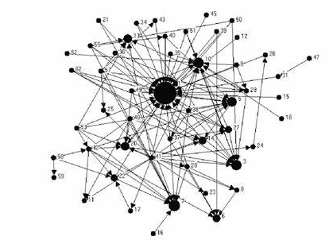
Sources
Warrants
Claims
Are there identifiable features of students’ citation practices that we can use as insights for our teaching?
Notes:
Moore, Spencer & Shiell, Alan & Hawe, Penelope & Haines, Valerie. (2005). The Privileging of Communitarian Ideas: Citation Practices and the Translation of Social Capital Into Public Health Research. American Journal of Public Health. 95. 1330-7. 10.2105/AJPH.2004.046094.

Slide 6
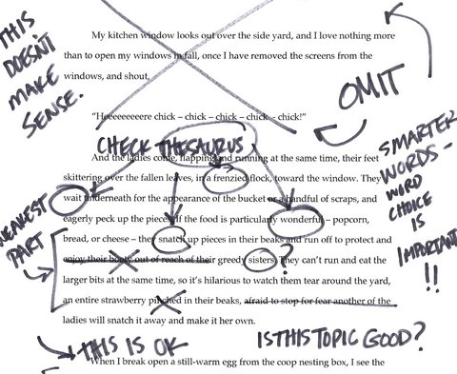
The data I used
Noisy!
Complex
Closed
Notes:
UG dissertation, part 1
Specialised but …
Selection – marked before I knew I was to use them
Similar standard
Closed source
Ethics – practitioner research

Slide 7
These are some of the things I investigated
They are interesting because …

Slide 8
This is what I discovered
(relating to the problem I’m solving)

Slide 9
This is my summary
And here is a nice chart to illustrate it

